Slide 1
KINETICS OF A SECOND-ORDER REACTION Part one
Muaathe A Ibraheem
Chemistry Department, College of sciences
University of Diyala

Slide 2
Objective and Theory
OBJECTIVE :To determine the rate constant of a second-order reaction, the saponification of ethyl acetate.
Theory: Fat ester hydrolysis in alkali media is named as saponification ( Soap making) In recent years the term been used to refer to esters hydrolysis in alkali condition.
Saponification of Ethyl acetate is written as
$$CH_{3}COOC_{2}H_{5}+ Na^{+}−OH^{−} → CH_{3}COONa+ C_{2}H_{5}OH$$
T=0 a b zero zero
T=t a-x b-x x x

Slide 3
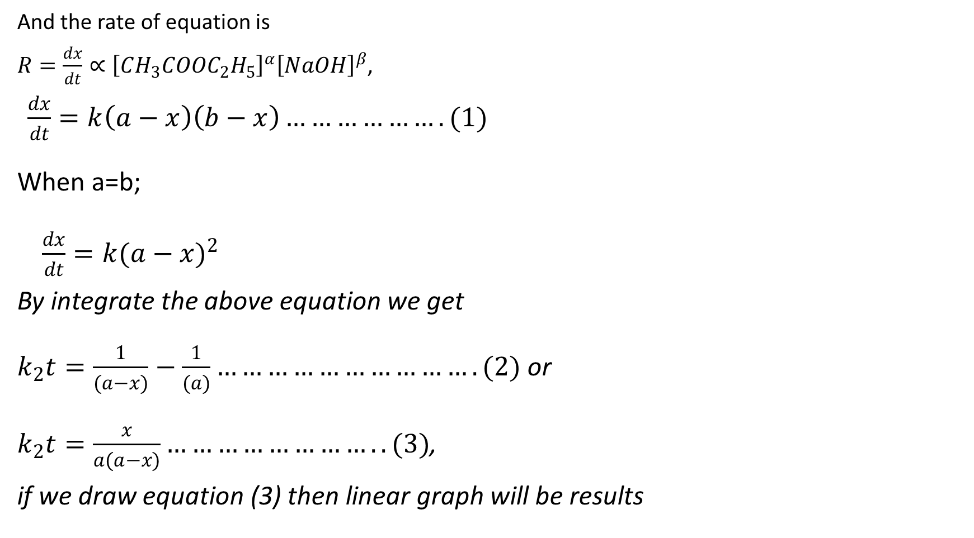
And the rate of equation is
$R=\frac{dx}{dt}∝{\left[CH_{3}COOC_{2}H_{5}\right]}^{α}{\left[NaOH\right]}^{β}$,
$\frac{dx}{dt}=k\left(a−x\right)\left(b−x\right)……………….(1)$
When a=b;
$\frac{dx}{dt}=k(a−x)^{2}$
By integrate the above equation we get
$k_{2}t=\frac{1}{(a−x)}−\frac{1}{(a)}………………………….(2)$ or
$k_{2}t=\frac{x}{a(a−x)}……………………..(3)$,
if we draw equation (3) then linear graph will be results

Slide 4
In this experiment a revers titration is recommended to get more accurate results
And if the equation (2) and (3) are substituted with corresponding volume of the titrate then
$k_{2}t=\frac{1}{(V_{∞}−V_{t})}−\frac{1}{(V_{∞})}$ ………………(4)
And equation (3) will be
$k_{2}t=\frac{V_{t}}{V_{∞}(V_{∞}−V_{t})}$……………………(5)
For second order reaction the half time reaction is
$$t_{1/2=}\frac{1}{k_{2}a}$$

Slide 5
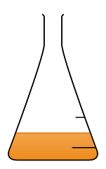
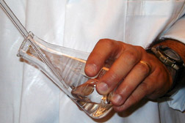
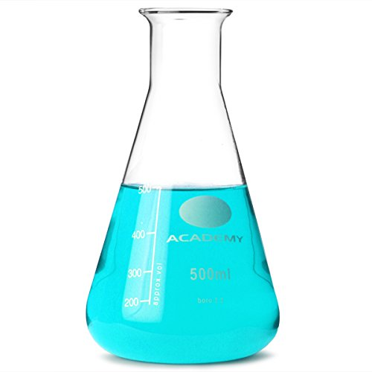
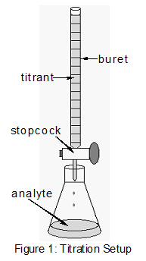
Procedure
1
2
3
50 ml of 0.05M CH₃COOEt + 50 ml 0f ).05M NaOH
10 ml of the mixture will be taken after 3 min and transfer to another conical flask
10 ml of both 0.025M HCl solution will be added and distilled water
4
4
Titrate the excess of acid with 0.025M of NaOH solution using of Ph.Ph. As indicator
Repeat step 2-4 every 3 min

Slide 6
Calculation
Note The value of V∞ = 10 ml cause all the ester is react with base and remain the only 10 ml of the acid which has been added to the mixture, so it will need also 10 ml of NaOH
Time min | V_{t} | V∞ | 1/(V_{t}-V∞ )
3
6
9
12
15
Draw either eq. (4) or (5) and determine K and also V∞

